Slide 1
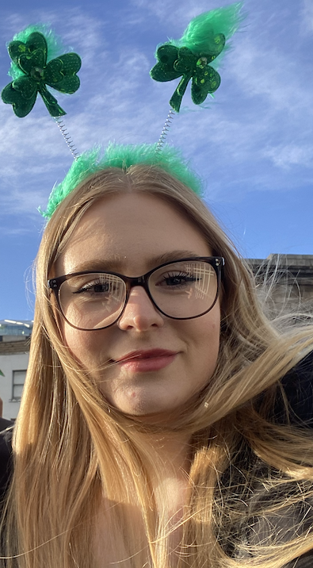
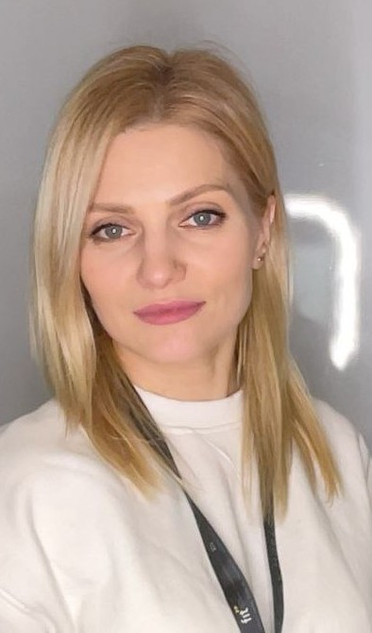

Web app: TempSafe
Team: Smart box
DkIT
Dundalk Institute of Technology
Smart Temperature Monitoring for a Controlled Drug Box
Nikita Smiichyk
  Maryna Hordiienko
Hanna Bokariuk
Backend/Database, Testing
Hardware, UI/UX/UD
Front-End, UI/UX/UD
Team member 1
Team member 2
Team member 3
GROUP
COURSE
SCRUMWISE
Sd3a
BSc (Hons) Computing in
Software Development
https://www.scrumwise.com/scrum/#/overview/project/l8-yr3-sd3a-2026-27-smart-box/id-31429-139568-58
MODULE
Universal Design Project
06/11/2026

Slide 2
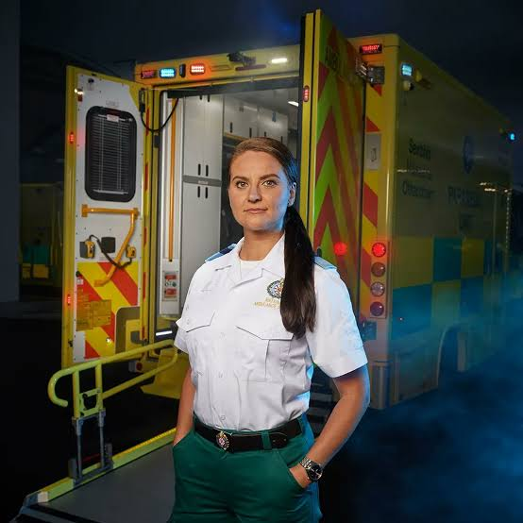
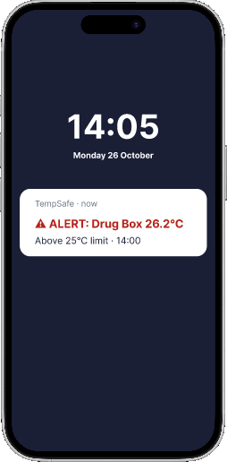
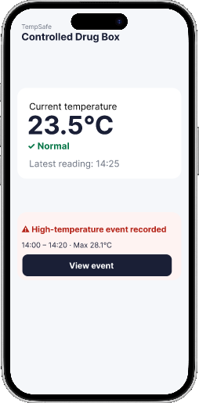
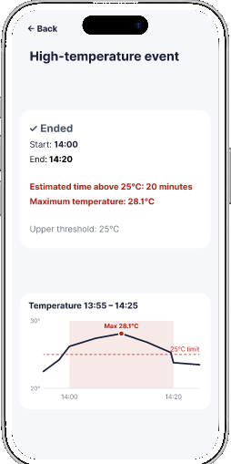
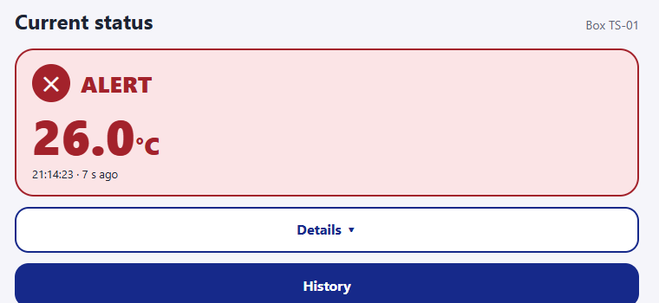
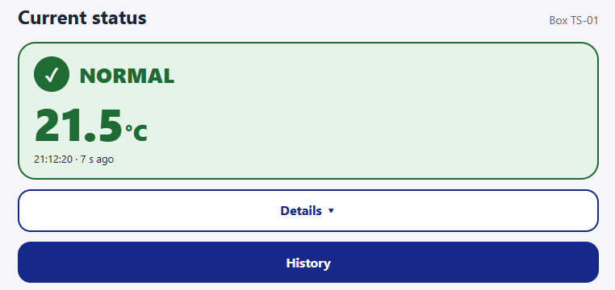
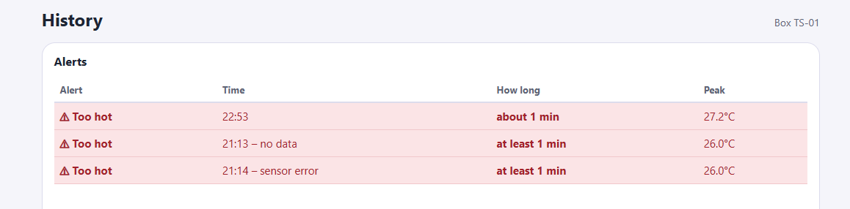
Shannon's main use case
Designed for Advanced Paramedics
Reviewing a temperature excursion after patient care
How might we help Shannon notice a problem in one glance, without distracting her?
1
14:00 · DURING THE CALL
Alert: box at 26.2°C
2
14:25 · ONE GLANCE
Normal again: 23.5°C
3
AFTER THE CALL
20 min too hot, peak 28.1°C
FIGMA PROTOTYPE
Shannon Rice
Advanced Paramedic · Ireland
GOAL
Keep temperature-sensitive drugs safe
PAIN POINTS
• Can't leave a patient to check the drug box
• Too many notifications distract her
SCENARIO
Hot day. 14:00 alert at 26.2°C, peak 28.1°C, back to Normal at 14:20
WORKING WEBSITE
Status card: ALERT + icon + °C
Status card: NORMAL, updates every 5 s
Alerts table: how long + peak
UD P4 Perceptible: never colour alone — icon + word + °C · high contrast · alt text
Notes:
MARYNA (about 60 s)
This is our persona, Shannon Rice, an Advanced Paramedic in Ireland. She can't leave a patient to check the drug box, and too many notifications distract her.
So we asked: how might we help Shannon notice a problem in one glance, without distracting her from her patient?
Our main use case has three steps.
It is a hot day. One: at 14:00 the box reaches 26.2 degrees and the alert reaches her lock screen. She keeps treating the patient.
Two: at 14:25 she opens the app. The box is Normal now, 23.5 degrees, and she sees that an event was recorded.
Three: she opens the event: 14:00 to 14:20, about 20 minutes above 25, maximum 28.1 degrees.
Top row is our Figma prototype, bottom row is the working website.
This follows UD Principle 4, Perceptible Information: never colour alone. We use an icon, a word and the temperature, with high contrast, and alt text for screen readers.

Slide 3







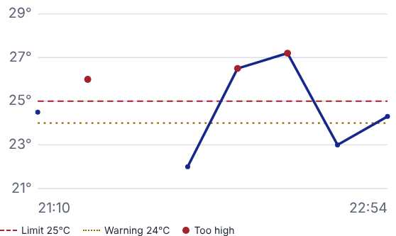
TempSafe system architecture
Backend and database
Medication box
EC2 /
UBUNTU
SERVER
MQTT broker
MQTT worker
Routes messages
Checks the box ID and
Temperature sensor
by topic
saves valid readings
Web browser
Stores readings
Nginx
FastAPI
Forwards web requests
Checks access and
to FastAPI
returns box history
Send reading
Return readings
Request history
Confirm reading saved
MoSCoW prioritisation
Project priorities
ONLY PRIORITY CHANGE
FR-13 Estimate time outside temperature limits
Should Have → Must Have
By the time Shannon checks the box, it may be back in range.
She still needs the duration and peak.
What have we delivered?
15 requirements / Reviewed 6 November 2026
Priority | ✓ Done (3) | ◐ In progress (10) | ◯ Planned (2)
Must Have | FR-05 Reading classification FR-10 Duplicate and late uploads | FR-01 Sign-in/out · FR-02 Box access FR-03 Temperature recording FR-04 Latest reading and age FR-06 LED warning · FR-07 History FR-08 Contact loss · FR-09 Offline buffer FR-13 Time outside limits | FR-14 Phone notifications
Should Have | FR-11 Dashboard auto-refresh | FR-15 Audible buzzer alert | FR-12 Mark a flagged sample as reviewed
Could Have | Possible follow-up: a native mobile app.
Won’t Have this time | Outside this release: active cooling, GPS, lid detection, extra sensors and ambulance-system integration; patient or medication records, automated clinical decisions and clinical deployment.
Notes:
Architecture
Follow one reading across the top row. The box sends it to the MQTT broker, which routes it to our worker. The worker checks the message format and box ID, saves the reading in MySQL, then sends confirmation back. If the connection drops before the box receives that confirmation, the box sends the same reading again. The sample ID lets the worker recognise a repeat, so it appears only once in history.
Now follow the lower row. When Shannon opens History, her browser asks for the readings. Nginx forwards the HTTPS request to FastAPI. FastAPI checks that she has access to this box, reads its history from MySQL and returns the data through Nginx. The browser draws the temperature graph.
Click once. The blue panel rises to show the project’s MoSCoW review.
MoSCoW prioritisation
FR-13 was the only requirement we moved. At first we thought the temperature graph was enough. Then we considered what Shannon would need after a call: the box might be back in range, but she would still need to know how long it was outside the limits and the peak temperature. That made an excursion summary essential. We mark the duration as an estimate because we only know what the sensor recorded.
At our 6 November code review, three of the fifteen requirements were complete: reading classification, handling duplicate and delayed uploads, and automatic dashboard refresh. Ten were in progress and two were planned. The Pi records temperatures, but always treats its clock as reliable. The website already estimates the duration and peak of an excursion. We kept FR-13 in progress because a missing sample can still join two periods together.
The two planned features have different priorities. Phone notifications are a Must Have because staff may be away from the box. Recording that someone reviewed a flagged sample is a Should Have: staff can still inspect the history without it. A native mobile app is a possible follow-up. Active cooling and clinical deployment are outside this monitoring prototype.
Sources: docs/requirements/moscow-prioritisation.md (6 November 2026 code review), docs/requirements/main-use-case.md, docs/mqtt.md, backend/temsafe/mqtt.py, backend/temsafe/api/boxes.py and deploy/tempsafe-nginx.conf. The monitor shows the project website. AWS, MySQL and FastAPI artwork from Devicon. NGINX mark from Simple Icons.

Slide 4
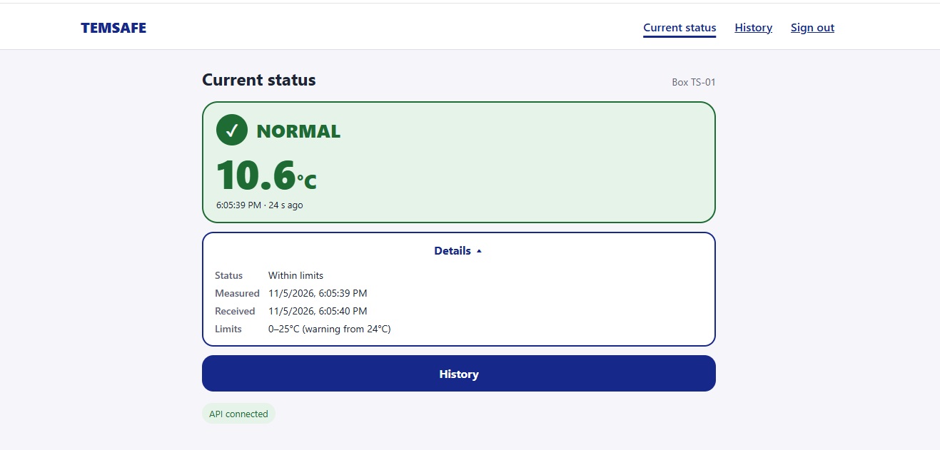
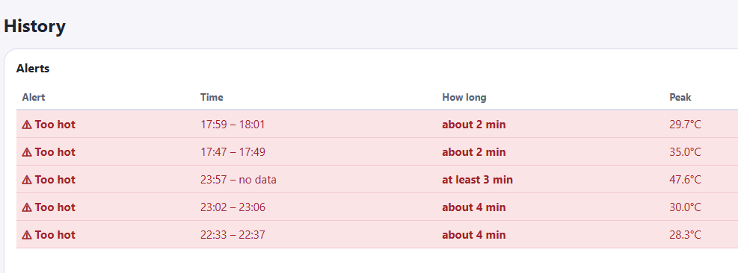
Usability Evaluation Findings & Planned Improvements
!
Alert: High temperature detected
View
1
2
1. Current Status: Show an unread temperature alert and add a View event button.
Last measured: 11/05/2026 6:05pm
2. Details: Remove duplicated information and show one clear timestamp —
Last measured.
Date
5 Nov 2026
3. History: Add the date to each event.
3

Slide 5
TempSafe
Thank you for
your attention
Any questions?
We’re happy to answer them.

